Slide 1
C++ A Compiler’s Perspective
Darshan Bhat

Slide 2
Agenda
Who am I ?
What to expect & not to ?
Compiler motivation
Compiler family
RISC vs CISC
Intro to Clang & LLVM
Optimization examples
Intro to JIT ( if time permits)

Slide 3
Who am I ?
Graduated in E & C from PES university
M.Tech in Information Technology from IIIT Bangalore
Work in between hardware and software ( Compilers ☺ )
Currently employed by Intel

Slide 4
What to expect from the talk ?
I am not a C++ expert !
This talk is more about how a compiler sees a language, not about
the C++ advanced concepts and tricks
Having the compiler knowledge will give you more insight and confidence about the language.
Basics of compilers and LLVM, not an advanced talk in compilers.
Interrupt me anytime, lets make it more interactive.

Slide 5
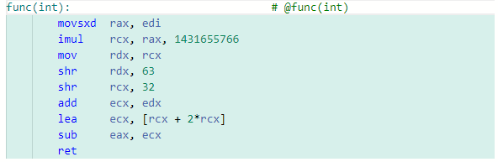
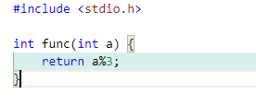
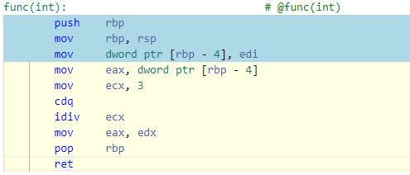
What is this code doing ?
-O2
-O0
https://godbolt.org/z/aMznenzMG

Slide 6
Why do we need compilers ?
Hardwares understand only bits ( assembly)
Only crazy people code in assembly ☺
Modern compilers will outperform reasonably hand-written assembly
Easy to re-target the code for different numbers for architectures / hardwares
Most of the high-level languages are built on top hard work done by compiled
languages.

Slide 7

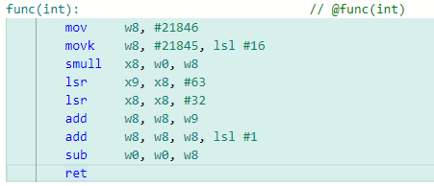
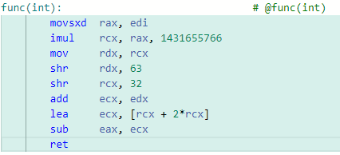
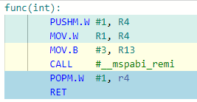
Different architectures
MIPS
ARM 64 bit
x86 64 bit

Slide 8
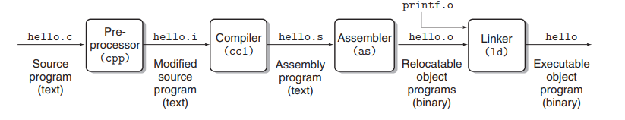
Compilation System
GNU assembler
VASM
MASM
LLLVM-inbuilt
GNU ld
GNU gold
LLVM lld
MSVC link.exe
clang -E hello.c (preprocessed)
clang -s hello.c (Assembly)
clang -c hello.c (Object)
clang hello.c (Object / exe)

Slide 9
Compiled languages
C & C++
x86
Rust
ARM
Compiler
Go
Web assembly
Java
Bytecode

Slide 10
Family of C++ compilers
Name | Max standard support
Clang | C++20
GCC | C++20
AOCC (AMD) | C++20
MSVC | C++20
ICC (Intel) | C++17
Armcc (ARM) | C++14

Slide 11
LLVM & Clang
LLVM stands for Low Level Virtual Machine
Project started in 2000, aimed for providing common IR for static and
dynamic languages
Clang (C&C++)
x86
llgo (go)
ARM
Flang (fortran)
LLVM
Web assembly
Rust
MIPS

Slide 12
Instruction Set Architecture (ISA)
Set of instructions defined by a Hardware
Primary abstraction between software and hardware
Example of x86 ISA
“imul” could be implemented using different
logic ( hardware) by different vendors
x86 vendors : Intel, AMD, VIA, Zhaoxin
ARM vendors : Apple, Broadcom, Nvidia, Samsung

Slide 13
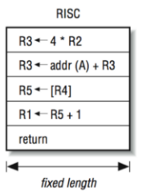
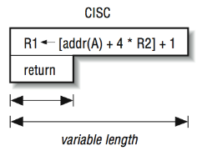
RISC vs CISC
CISC
RISC
Compiler
Compiler
Greater complexity
Greater complexity
Processor
Processor

Slide 14
Compiler anatomy
Front end
Middle end
Backend
Language parsing
AST construction
AST transformation
Various llvm IR transformation
Instruction selection
Machine specific transforms
Code emission ( assembly)

Slide 15
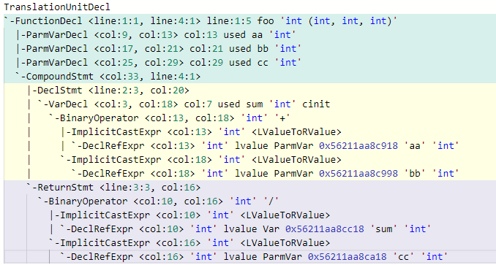

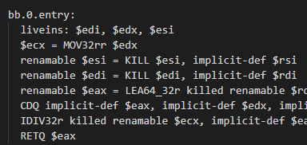
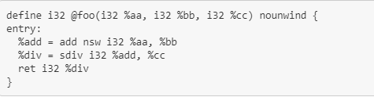
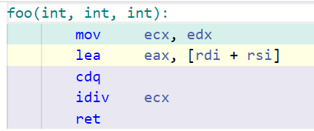
Progressive Lowering

Slide 16
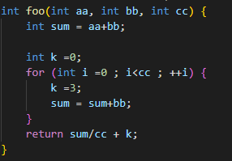
Why so complex ?
Why not build a one pass compiler or string manipulator ?
But, could you detect that ‘k’ is a loop invariant ?
What is 3 x 4 ?
What is 0111 x 0100 ?
foo(int, int, int):
mov rbp, rsp
add eax, dword ptr [rbp - 8]
mov dword ptr [rbp - 20], 0
.LBB0_1:
<>
<>
jmp .LBB0_1
.Lbb0_2:
idiv dword ptr [rbp - 12]
add eax, dword ptr [rbp - 20]
ret

Slide 17
Clang AST
return
/
sum
cc
https://godbolt.org/z/hYW16nWKb

Slide 18
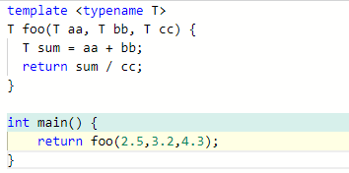
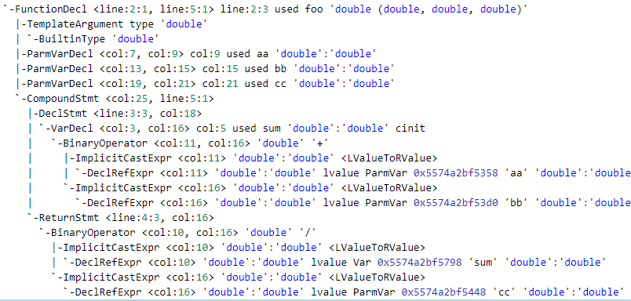
Template instantiation

Slide 19
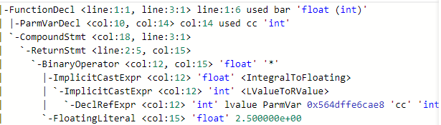
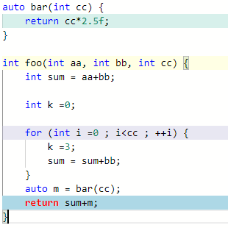
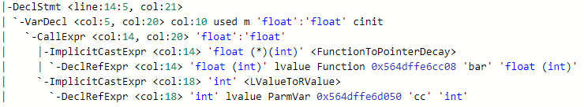
Auto deduction

Slide 20
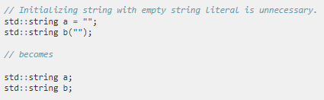

AST consumer projects
After building AST lots of code analysis can be done.
Clang sub-project called “Libtooling” allows people to write code analysis tools using AST
Clang-tidy is a famous Libtool which has various code analysis checks
readability-duplicate-include
readability-redundant-string-init
performance-faster-string-find
https://clang.llvm.org/extra/clang-tidy/checks/list.html
https://clang.llvm.org/docs/LibASTMatchersTutorial.html

Slide 21
LLVM IR

Slide 22
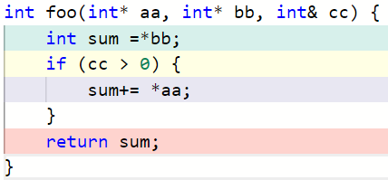
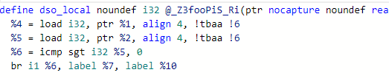


LLVM IR
Basic blocks are formed
Code inside each BB is linear

Slide 23
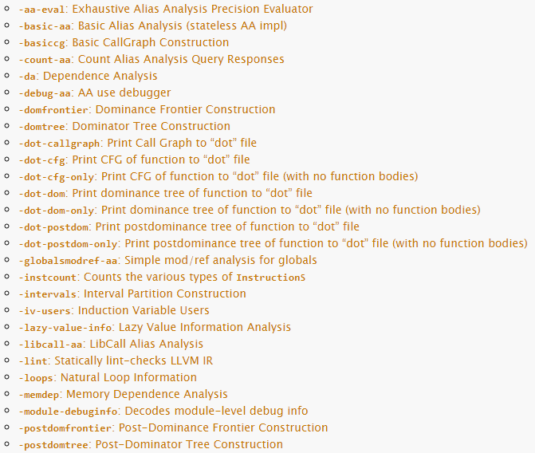
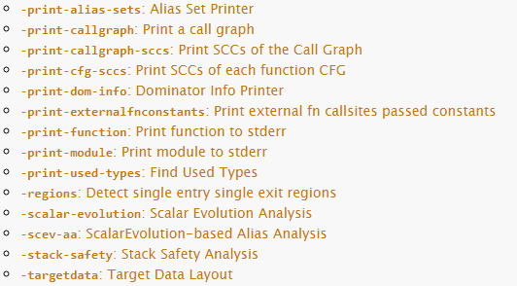
LLVM Analysis Passes
https://llvm.org/docs/Passes.html

Slide 24
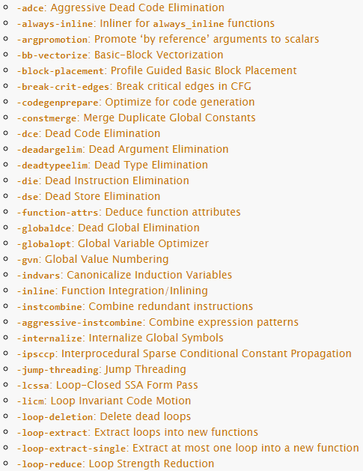
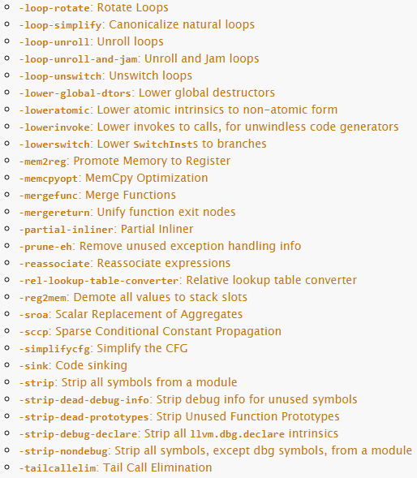
LLVM optimizations

Slide 25
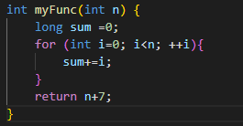
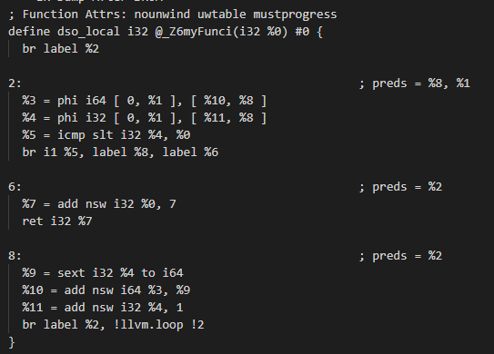
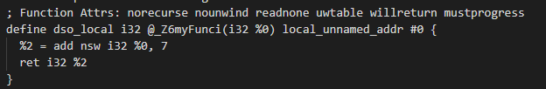

Example optimization : DCE
clang++ -O2 -Wall -std=c++11 -c -mllvm –print-after=adce Test.cpp
After Dead Code Elimination
Initial IR
Final assembly

Slide 26
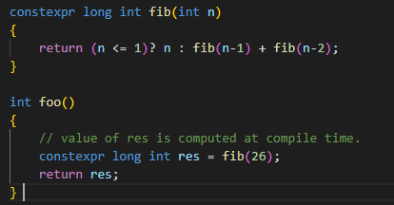
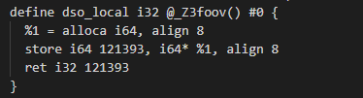
Example optimization : ConstExpr
clang++ -O2 -Wall -std=c++11 -c -mllvm –print-after-all Test.cpp
Initial IR
Initial IR already contains the constant value, that means the evaluation is done in AST transformation itself.
https://www.youtube.com/watch?v=LgrgYD4aibg

Slide 27
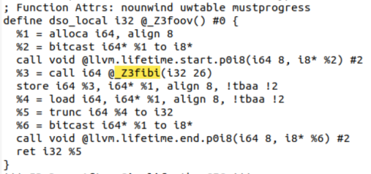
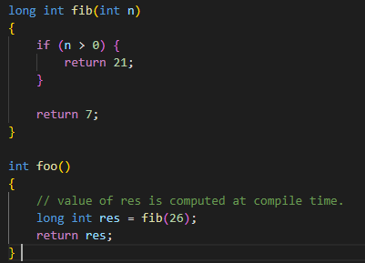
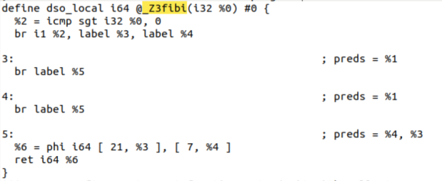

Inter-procedural constant propagation
After constant propagation pass
Initial IR

Slide 28
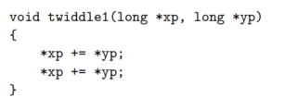

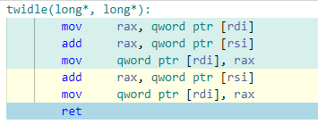
Tricky optimizations
=
?
Loads xp from memory to rax
*xp = *xp + *yp
*xp = *xp + *yp
Result will be different when ‘xp’ and ‘yp’ are pointing to the same memory location
Every optimization should guarantee numerical correctness
Alias analysis will be used to prove such equivalence

Slide 29


Compiler hints
With restrict keywork
New
Old
Compiler hints / pragmas will help compilers to do more optimizations
Behavior will be undefined if the user breaks the contract
#pragma unroll
__attribute__((noinline))
__attribute__((align_value(128))
https://releases.llvm.org/4.0.0/tools/clang/docs/AttributeReference.html

Slide 30
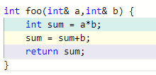
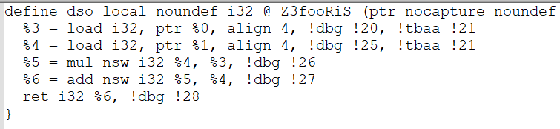
LLVM SSA
int foo(int& a, int& b) {
int sum = a*b;
int sum1 = sum+b;
return sum1
}
=
Static Single Assignment (SSA) form

Slide 31
LLVM Use-Def Analysis
Def Instruction
Use Instruction
Def Instruction
Use Instruction
How will you write a simple dead code elimination using this analysis ?

Slide 32

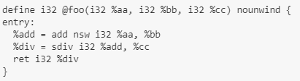
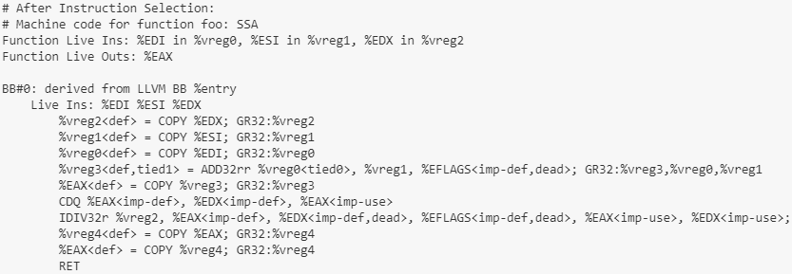
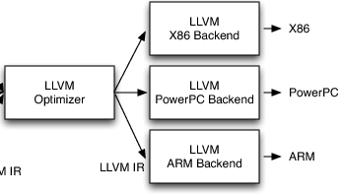
Instruction Selection
LLVM IR
Isel-Lowering
Machine IR

Slide 33
Modularity of LLVM
$ clang -Xclang -ast-dump -fsyntax-only test.cc
$ clang -S -emit-llvm foo.c -o foo.ll
$ opt -adce input.ll -o output.ll
$ llc –march=<> -mcpu=<> input.ll –o output.s

Slide 34
JIT Compilation
Just In Time Compilation
Tradeoff between Compile time vs Run time
Interpreted languages vs Compiled Languages
JIT is best of both the worlds
Java is one of the example of JIT kind of compilation

Slide 35
LLVM JIT
Execute
Execute
JIT Engine
Execute
On the fly compilation + execution
JIT Engine should support the target hardware ( x86, ARM etc)
$ clang -emit-llvm -c sum-main.c -o sum-main.bc
$ lli sum-main.bc

Slide 36
Resources
https://llvm.org/
https://clang.llvm.org/
https://llvm.org/docs/Passes.html
THANK YOU

